Slide 1
EDS PROJECT
GUIDED BY MADHAVI NIMKAR
PRESENTED BY
GAYATRI NAROTE(643)
VAISHNAVI PAWAR(649)
KANCHAN GAIKWAD(652)
KIRAN SHINDE(655)

Slide 2
INTRODUCTION
Python has a simple syntax similar to the English language. Python has syntax that allows developers to write programs with fewer lines than some other programming languages.
This project involves data manipulation, data visualization and linear regression.
We choose cricket dataset for this project

Slide 3
MOTIVATION
The cricket dataset is always big because its involves sixes, fours, century and so many things.
The curiosity of manipulating such a big dataset.
Its include numerical as well as float datatypes

Slide 4
DETAILS OF DATASET
The provided data appears to be a list of cricket players with their respective statistics in Twenty20 International matches
The table includes information such as the player's name, their country or representation, the span of their career, the number of matches played (Mat), innings batted (Inns), not outs (Not out), total runs scored (Runs), highest score (HS), batting average (Ave), balls faced, strike rate (SR), number of centuries (100), number of half-centuries (50), number of times dismissed without scoring (0), number of fours hit (4s), and number of sixes hit (6s).

Slide 5
DATA MANIPULATION
import pandas as pd
import numpy as np
import matplotlib.pyplot as plt
df=pd.read_csv('/content/cricket.csv')
df
Player Span Mat Inns Not out Runs HS Ave ball faced SR 100 50 0 4s 6s
0 V Kohli (INDIA) 2010-2019 75 70 20 2633 94* 52.66 1907 138.07 0 24 2 247 71
1 RG Sharma (INDIA) 2007-2019 104 96 14 2633 118 32.10 1905 138.21 4 19 6 234 120
2 MJ Guptill (NZ) 2009-2019 83 80 7 2436 105 33.36 1810 134.58 2 15 2 215 113
3 Shoaib Malik (ICC/PAK) 2006-2019 111 104 30 2263 75 30.58 1824 124.06 0 7 1 186 61
4 BB McCullum (NZ) 2005-2015 71 70 10 2140 123 35.66 1571 136.21 2 13 3 199 91
5 DA Warner (AUS) 2009-2019 76 76 8 2079 100* 30.57 1476 140.85 1 15 5 203 86
6 EJG Morgan (ENG) 2009-2019 86 84 17 2002 91 29.88 1475 135.72 0 11 3 151 96

Slide 6
OUTPUT
0 V Kohli (INDIA) 2010-2019 75 70 20 2633 94*
1 RG Sharma (INDIA) 2007-2019 104 96 14 2633 118
2 MJ Guptill (NZ) 2009-2019 83 80 7 2436 105
3 Shoaib Malik (ICC/PAK) 2006-2019 111 104 30 2263 75
4 BB McCullum (NZ) 2005-2015 71 70 10 2140 123
5 DA Warner (AUS) 2009-2019 76 76 8 2079 100*
6 EJG Morgan (ENG) 2009-2019 86 84 17 2002 91
7 Mohammad Shahzad (AFG) 2010-2018 65 65 3 1936 118*
8 JP Duminy (SA) 2007-2019 81 75 25 1934 96*
9 PR Stirling (IRE) 2009-2019 72 71 6 1929 91
10 Mohammad Hafeez (PAK) 2006-2018 89 86 8 1908 86
11 TM Dilshan (SL) 2006-2016 80 79 12 1889 104*
12 AJ Finch (AUS) 2011-2019 58 58 9 1878 172
13 LRPL Taylor (NZ) 2006-2019 95 87 19 1743 63
14 Umar Akmal (PAK) 2009-2019 84 79 14 1690 94
15 AB de Villiers (SA) 2006-2017 78 75 11 1672 79*
16 H Masakadza (ZIM) 2006-2019 66 66 2 1662 93*
17 AD Hales (ENG) 2011-2019 60 60 7 1644 116*
18 CH Gayle (WI) 2006-2019 58 54 4 1627 117
# Perform data manipulation operations
# Example: Sorting the dataframe by Runs in descending order
df_sorted = df.sort_values(by='Runs', ascending=False)
# Print the manipulated dataframe
print(df_sorted)

Slide 7
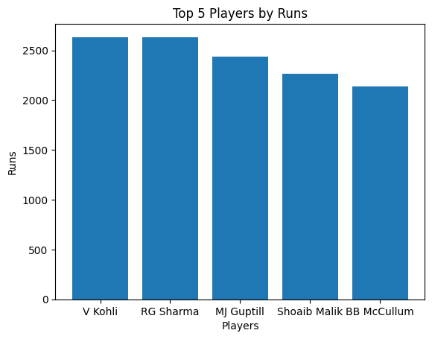
DATA VISUALIZATION
import matplotlib.pyplot as plt
# Prepare data
players = ['V Kohli', 'RG Sharma', 'MJ Guptill', 'Shoaib Malik', 'BB McCullum']
runs = [2633, 2633, 2436, 2263, 2140]
# Create a bar chart
plt.bar(players, runs)
# Customize the chart
plt.title('Top 5 Players by Runs')
plt.xlabel('Players')
plt.ylabel('Runs')
# Display the chart
plt.show()

Slide 8
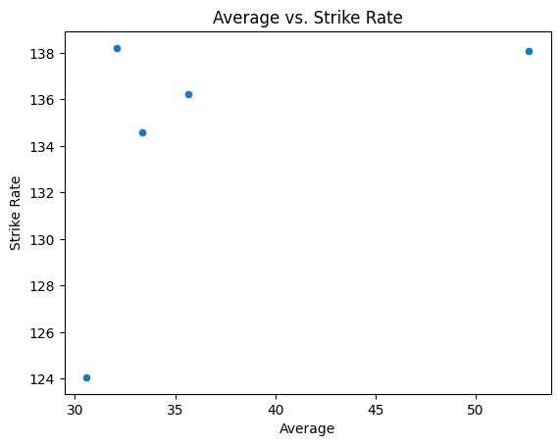
import seaborn as sns
# Prepare data
averages = [52.66, 32.1, 33.36, 30.58, 35.66]
strike_rates = [138.07, 138.21, 134.58, 124.06, 136.21]
# Create a scatter plot
sns.scatterplot(x=averages, y=strike_rates)
# Customize the plot
plt.title('Average vs. Strike Rate')
plt.xlabel('Average')
plt.ylabel('Strike Rate')
# Display the plot
plt.show()

Slide 9
import matplotlib.pyplot as plt
# Prepare data
players = ['V Kohli', 'RG Sharma', 'MJ Guptill', 'Shoaib Malik', 'BB McCullum']
years = range(2010, 2020) # Assuming the data is for 2010-2019
runs = [
[2633, 2436, 2263, 2140, 2079, 2002, 1936, 1934, 1929, 1908],
[0, 0, 0, 0, 0, 0, 0, 0, 0, 2633],
[0, 0, 2436, 0, 0, 0, 0, 0, 0, 0],
[0, 0, 0, 2263, 0, 0, 0, 0, 0, 0],
[0, 0, 0, 0, 2140, 0, 0, 0, 0, 0]
]
# Create a line chart for each player
for i in range(len(players)):
plt.plot(years, runs[i], label=players[i])
# Customize the chart
plt.title('Runs over Time')
plt.xlabel('Year')
plt.ylabel('Runs')
plt.legend()
# Display the chart
plt.show()

Slide 10
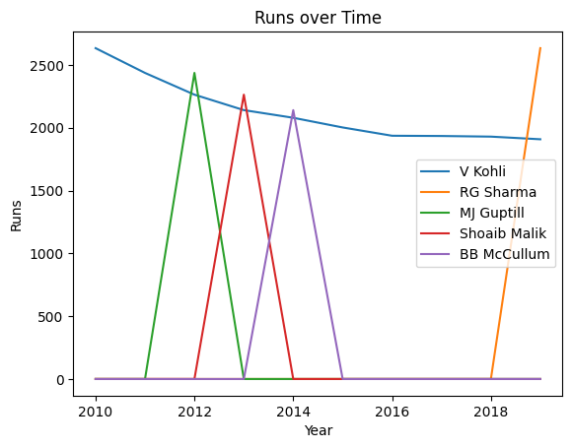

Slide 11
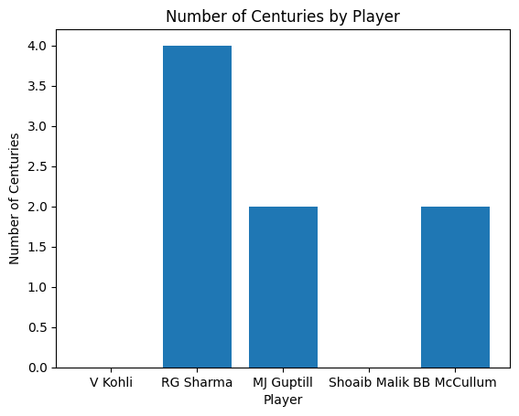
import matplotlib.pyplot as plt
# Prepare data
players = ['V Kohli', 'RG Sharma', 'MJ Guptill', 'Shoaib Malik', 'BB McCullum']
centuries = [0, 4, 2, 0, 2]
# Create a bar chart
plt.bar(players, centuries)
# Customize the chart
plt.title('Number of Centuries by Player')
plt.xlabel('Player')
plt.ylabel('Number of Centuries')
# Display the chart
plt.show()

Slide 12
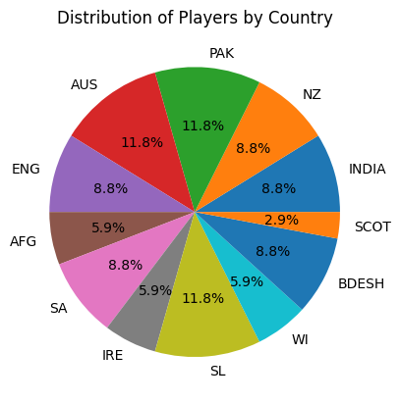
import matplotlib.pyplot as plt
# Data for the pie chart
countries = ['INDIA', 'NZ', 'PAK', 'AUS', 'ENG', 'AFG', 'SA', 'IRE', 'SL', 'WI', 'BDESH', 'SCOT']
counts = [3, 3, 4, 4, 3, 2, 3, 2, 4, 2, 3, 1]
# Create the pie chart
plt.pie(counts, labels=countries, autopct='%1.1f%%')
# Add a title
plt.title('Distribution of Players by Country')
# Display the chart
plt.show()

Slide 13
LINEAR REGRESSION (LR)
import pandas as pd
from sklearn.linear_model import LinearRegression
# Create a dataframe from the given data
data = {
'Player': ['V Kohli', 'RG Sharma', 'MJ Guptill', 'Shoaib Malik', 'BB McCullum', 'DA Warner', 'EJG Morgan'],
'Inns': [70, 96, 80, 104, 70, 76, 84],
'Runs': [2633, 2633, 2436, 2263, 2140, 2079, 2002]
}
df = pd.DataFrame(data)
# Prepare the data for linear regression
X = df[['Inns']] # Independent variable (number of innings)
y = df['Runs'] # Dependent variable (runs)
# Create a linear regression model
model = LinearRegression()
# Fit the model to the data
model.fit(X, y)
# Predict runs for a player with 90 innings
predicted_runs = model.predict([[90]])
print(f"Predicted runs for a player with 90 innings: {predicted_runs[0]:.2f}")
OUTPUT
Predicted runs for a player with 90 innings: 2327.58

Slide 14
import pandas as pd
from sklearn.linear_model import LinearRegression
# Create a dataframe from the given data
data = {
'Player': ['V Kohli', 'RG Sharma', 'MJ Guptill', 'Shoaib Malik', 'BB McCullum', 'DA Warner', 'EJG Morgan'],
'4s': [247, 234, 215, 186, 199, 203, 151],
'6s': [71, 120, 113, 61, 91, 86, 96],
'Runs': [2633, 2633, 2436, 2263, 2140, 2079, 2002]
}
df = pd.DataFrame(data)
# Prepare the data for linear regression
X = df[['4s', '6s']] # Independent variables (number of 4s and 6s)
y = df['Runs'] # Dependent variable (runs)
# Create a linear regression model
model = LinearRegression()
# Fit the model to the data
model.fit(X, y)
# Predict runs for a player with 200 4s and 100 6s
predicted_runs = model.predict([[200, 100]])
print(f"Predicted runs for a player with 200 4s and 100 6s: {predicted_runs[0]:.2f}")
OUTPUT
Predicted runs for a player with 200 4s and 100 6s: 2286.65

Slide 15
APPLICATION
A DML (data manipulation language) refers to a computer programming language that allows you to add (insert), delete (delete), and alter (update) data in a database.
The graphical depiction of information and data is known as data visualisation. Data visualisation tools make it easy to view and comprehend trends, outliers, and patterns in data by utilising visual components like charts, graphs, and maps.
The data manipulation helps to understand data easily.
Data manipulation helps to sort the data and to find the highest and average runs of a player
Linear Regression helps to predict the runs of a player.

Slide 16
CONCLUSION
In conclusion ,we can analysis data of cricket dataset in various way.
Data manipulation, Data visualization and linear regression helps to analysis the data and it easier to understand.
And we can get exact meaning of data by using this function.

